Slide 1


Integrating Git, Gerrit and Jenkins/Hudson with Mylyn
Sascha Scholz

Slide 2
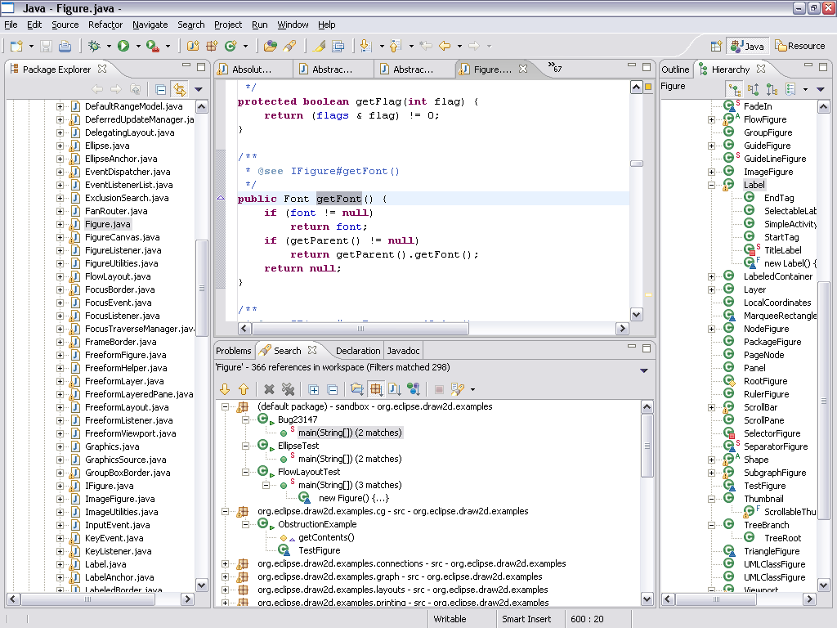
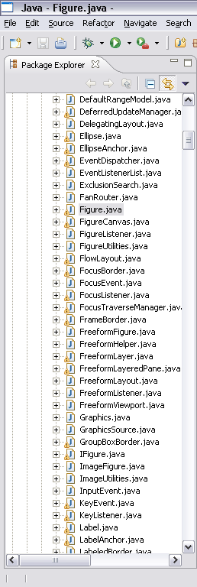
90% Irrelevant
Lack of integration – Friction Information overload – Distraction Context loss when multi-tasking

Slide 3
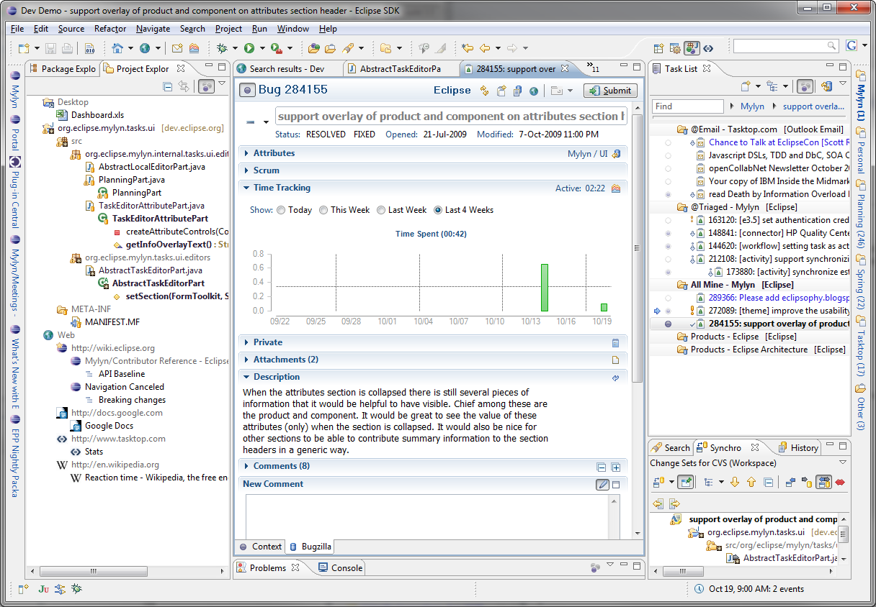
Task-Focused Interface
Tasks are integrated with the IDE
See only what you are working on
Notes:
Mylyn integrates with about every imaginable ALM system out there
We have eliminated friction from the developers workday
We switch task contexts in the blink of an eye
We are in a constant state of flow coding at the speed of thought

Slide 4






Mylyn Evolution
Tasks
Bugzilla
Trac
OSLC
Context
Java
C/C++
Versions
CVS
Git
OSLC
Docs
WikiText
RichText
Builds
Hudson
OSLC
Reviews
Tasks
Gerrit
IEEE
Notes:
Project started in 2004 on a white-board at the University of British Columbia
Evolved considerably and is now top-level project
New frameworks: Builds and Reviews
Mylyn: reference implementations for open source
OSLC for integration with IBM tools
Tasktop and other commercial add-ons: integrations for closed source
Evolution happens in two dimensions: artifacts and system integrations
Tasks: brings tasks into Eclipse
Context: bridges to enable mylyn to understand structure of domain objects for DOI and focusing
Team: change set management
Monitor: workbench interaction monitoring
WikiText: wiki rendering with extensible support for multiple languages
Tasks core framework is reusable in standalone and headless applications

Slide 5








Git
A distributed version control system originally built for the Linux kernel
Offline support
Local repository clone contains full history
Easy branching and merging
Typical workflow: commit, fetch, merge/rebase, push
EGit is an Eclipse team provider for Git
JGit is a lightweight Java library implementing Git
HEAD
1.0
G
D
F
feature-1
C
E
B
A

Slide 6

Jenkins/Hudson
Continuous Integration Server
Open source
Hudson was recently proposed as an Eclipse project
Jenkins is a fork of Hudson
Mylyn integrates with both

Slide 7

Gerrit
Web-based code review system based on JGit
Open source (Apache License 2.0)
Serves as a Git server adding access control and workflow
Used by
Android
JGit, EGit (other Eclipse projects want it…)
Google
SAP

Slide 8
Gerrit Workflow
Master branch contains only reviewed and approved changes
Each change is based on the master branch to have a stable starting point
Typical workflow
Make a change and commit it to your local Git repository
Push commit to Gerrit
Invite reviewers
Comments and discussions in the context of the change
Fetch it, test it, improve it, …
Create a new patch set and push to Gerrit (amend commit, old one is replaced)
Submit to master branch (or abandon it…)

Slide 9
Demo!

Slide 10

Build
Pull
Hudson
Vote
Push
Gerrit
Vote
Vote
Push
Git

Slide 11
Contribute!
Mylyn Reviews
http://www.eclipse.org/reviews
Mylyn Builds
http://www.eclipse.org/mylyn/builds
Egit/Jgit
http://www.eclipse.org/egit
Gerrit Code Review
https://review.source.android.com
Jenkins Gerrit Trigger
https://wiki.jenkins-ci.org/display/JENKINS/Gerrit+Trigger

Slide 12
Update Sites for Mylyn 3.5
Mylyn
http://download.eclipse.org/mylyn/releases/latest
Jenkins/Hudson Connector
Task List > New Task… > Install More Connectors
Gerrit Connector
http://download.eclipse.org/reviews/nightly
EGit
http://download.eclipse.org/egit/updates
Mylyn 3.6 will be released as part of Indigo on June 22.

Slide 13
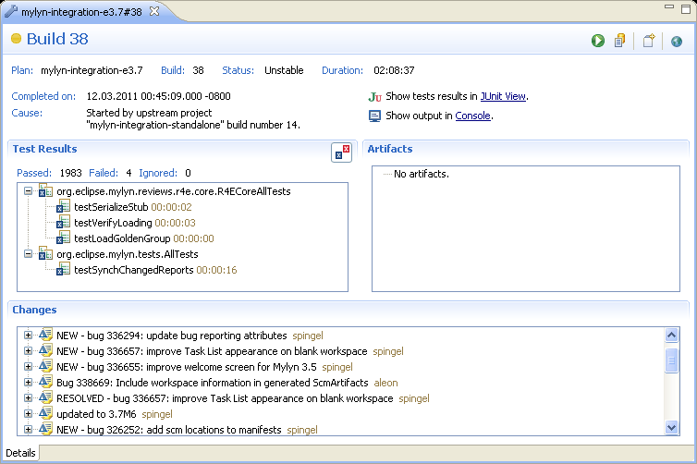
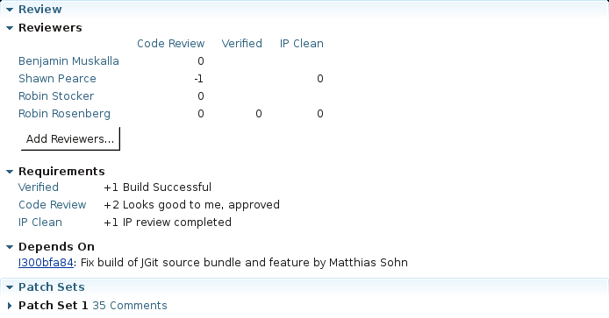
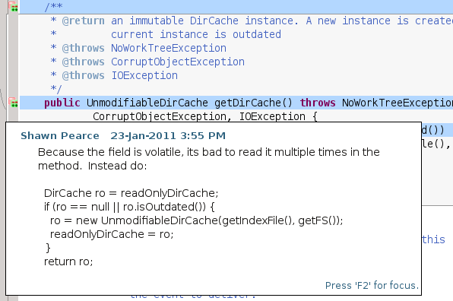
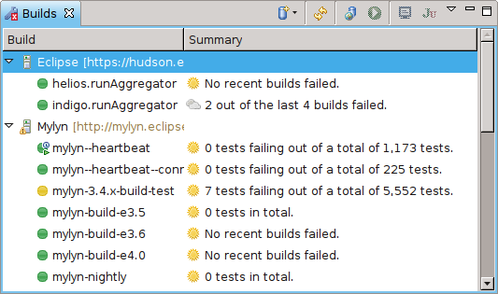
Questions?

